Slide 1


Department of Artificial Intelligence and Data Science
Crime Hotspot Prediction
Dr. Suresh Kumar S
Archana RM(231801011)
Deepika M(231801028)
Suhirtha MP(231801175)

Slide 2
Introduction
Need for Crime Analytics:
Rising urban crime rates require systematic monitoring.
Traditional reporting methods are slow and fragmented.
Project Motivation & Objectives:
Identify high-crime areas (“hotspots”) for timely intervention.
Provide authorities with a visual, interactive dashboard.
Enable data-driven decision making.

Slide 3
Abstract
Problem Overview:
Crime data scattered across cities and departments.
Manual hotspot detection is slow and error-prone.
Hard for authorities to track and respond to emerging patterns.
Proposed Solution:
A data-driven Crime Hotspot Analysis Dashboard.
Automatically analyzes and visualizes city-level crime data.

Slide 4
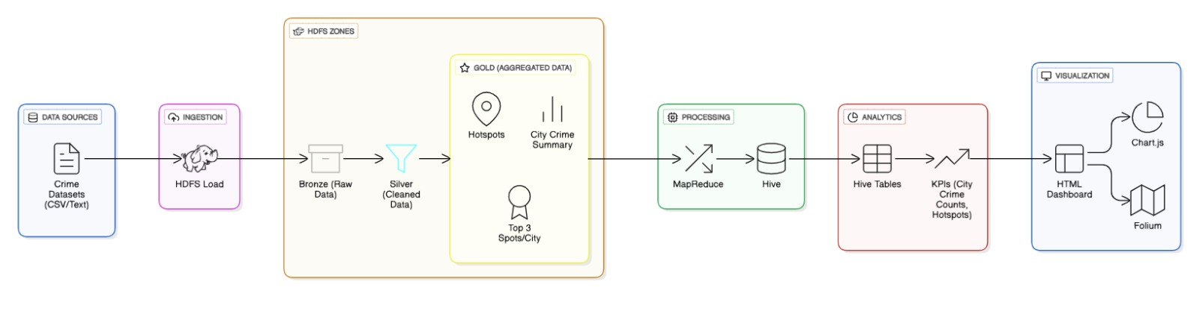
Architecture

Slide 5
Modules Overview
Data Collection: Crime data from police databases & open sources
Preprocessing: Clean missing values, format addresses, geocode coordinates
Hive Analysis: Query crime frequency, rank hotspots
Visualization: Map plots, pie charts, bar graphs
Dashboard: Web interface to explore crime hotspots interactively

Slide 6
Tools Used
Hive: Data storage & SQL-style queries
Hadoop: Distributed storage & processing
Python Libraries:
Folium – Interactive maps
Chart.js – Pie/bar charts for crime distribution
Frontend: HTML, CSS for dashboard interface
VMware Ubuntu: Virtual environment

Slide 7
Implementation
Steps:
Hive table creation for city-wise crime data
Execute queries for top hotspots and crime counts
Export results to CSV/JSON
Generate Folium maps
Build Chart.js pie charts
Integrate into HTML dashboard

Slide 8
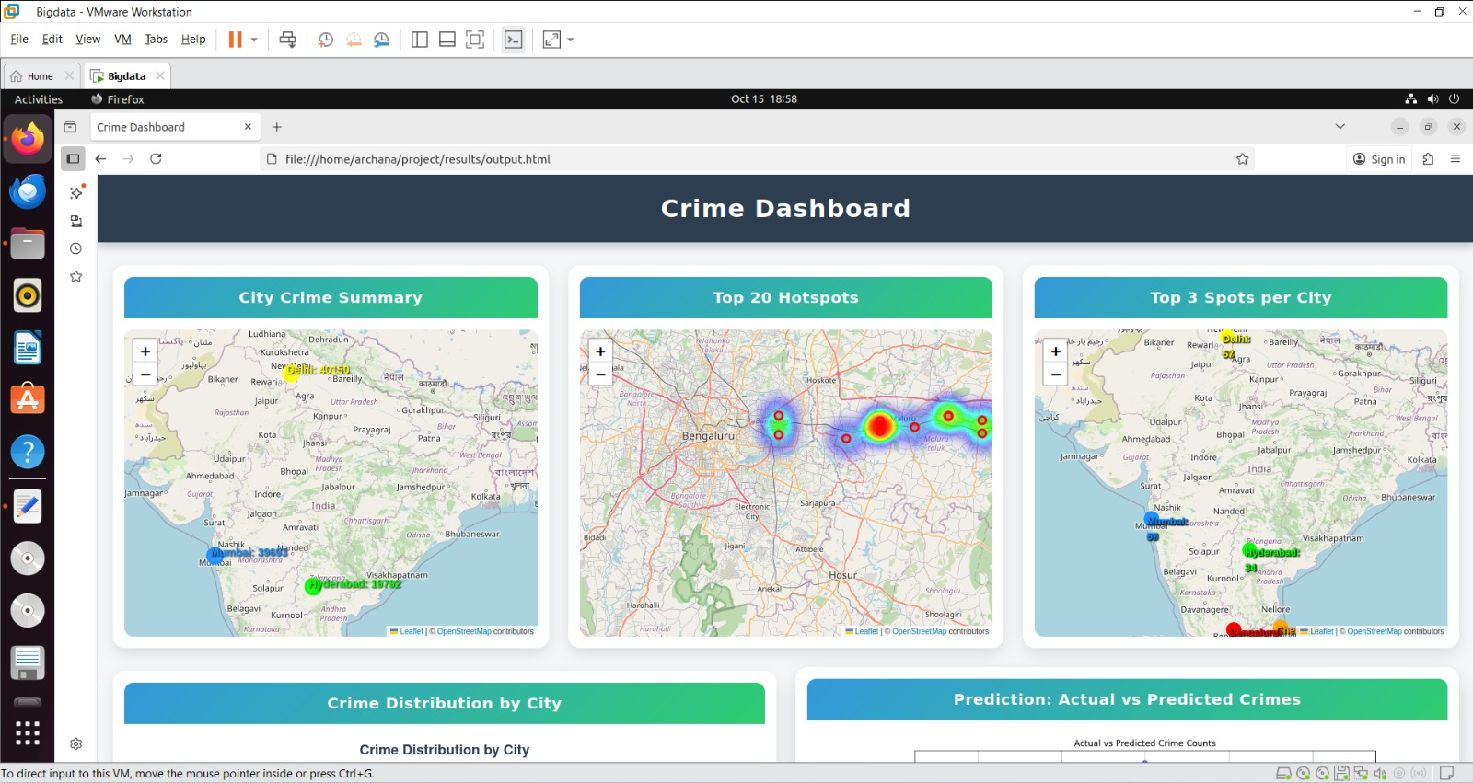
Dashboard Visualization

Slide 9
Results
Major Hotspots Identified:
The analysis revealed Bengaluru as the top city with the highest crime density.
Specific zones within these cities—like central Chennai and South Delhi—exhibit repeated crime occurrences.
Insights:
Visualization allows authorities to allocate resources effectively
Quick identification of emerging crime clusters

Slide 10
Conclusion & Future Scope
Conclusion:
System provides a simple, efficient way to visualize crime hotspots
Integrates data collection, analysis, and visualization in one dashboard
Future Enhancements:
Predictive analytics for forecasting crime
Real-time dashboard integration with police data feeds
Expansion to more cities and types of crimes

Slide 11
References
Apache Hive Documentation: https://cwiki.apache.org/confluence/display/Hive/Home
Folium Python Library: https://python-visualization.github.io/folium/
Chart.js Documentation: https://www.chartjs.org/
ResearchGate – Crime Pattern Analysis using Big Data
IEEE Access – Predictive Crime Mapping
Government Crime Data Portals

Slide 12
Thank You

